Slide 1
Customer Churn Prediction for Internet Service Providers
- Uday Vadecha

Slide 2
Data analysis
Data Table :
id | is_tv_subscriber | is_movie_package_subscriber | subscription_age | bill_avg | remaining_contract | service_failure_count | download_avg | upload_avg | download_over_limit | churn
15 | 1 | 0 | 11.95 | 25 | 0.14 | 0 | 8.4 | 2.3 | 0 | 0
18 | 0 | 0 | 8.22 | 0 | NaN | 0 | 0.0 | 0.0 | 0 | 1
23 | 1 | 0 | 8.91 | 16 | 0.00 | 0 | 13.7 | 0.9 | 0 | 1
27 | 0 | 0 | 6.87 | 21 | NaN | 1 | 0.0 | 0.0 | 0 | 1
34 | 0 | 0 | 6.39 | 0 | NaN | 0 | 0.0 | 0.0 | 0 | 1
Statistical Analysis of Data :
 | count | mean | std | min | 25% | 50% | 75% | max
is_tv_subscriber | 72274 | 0.82 | 0.39 | 0.00 | 1.00 | 1.00 | 1.00 | 1.00
is_movie_package_subscriber | 72274 | 0.33 | 0.47 | 0.00 | 0.00 | 0.00 | 1.00 | 1.00
subscription_age | 72274 | 2.45 | 2.03 | -0.02 | 0.93 | 1.98 | 3.30 | 12.80
bill_avg | 72274 | 18.94 | 13.22 | 0.00 | 13.00 | 19.00 | 22.00 | 406.00
reamining_contract | 50702 | 0.72 | 0.70 | 0.00 | 0.00 | 0.57 | 1.31 | 2.92
service_failure_count | 72274 | 0.27 | 0.82 | 0.00 | 0.00 | 0.00 | 0.00 | 19.00
download_avg | 71893 | 43.69 | 63.41 | 0.00 | 6.70 | 27.80 | 60.50 | 4415.20
upload_avg | 71893 | 4.19 | 9.82 | 0.00 | 0.50 | 2.10 | 4.80 | 453.30
download_over_limit | 72274 | 0.21 | 1.00 | 0.00 | 0.00 | 0.00 | 0.00 | 7.00
churn | 72274 | 0.55 | 0.50 | 0.00 | 0.00 | 1.00 | 1.00 | 1.00
Dataset Description
Total Records: 72,274
Total Features: 10 (including target variable churn)
Objective: Analyze customer behavior to predict churn and identify retention drivers.

Slide 3
Model architecture:
Data Ingestion
Feature Engineering
Exploratory Data Analysis (EDA)
Model Building- Logistic Regression
Evaluation & Insights

Slide 4


Slide 5
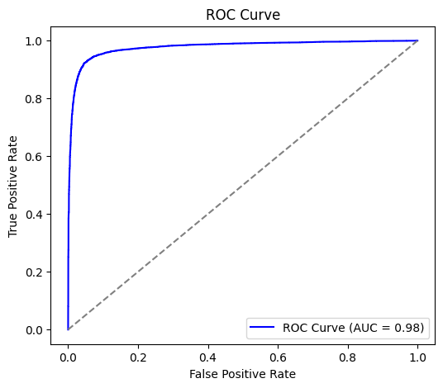
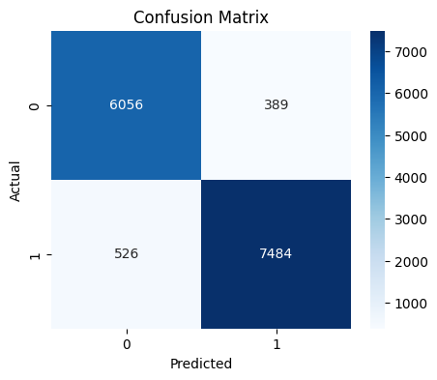
Model evaluation metrics
Accuracy: 0.88
Precision: 0.87
Recall: 0.92
F1 Score: 0.89
ROC AUC: 0.94

Slide 6
Model evaluation metrics
Feature | Importance
bill_avg_per_gb | 21.47724
remaining_contract | -15.0101
download_avg | -8.36535
avg_usage | -8.29051
bill_avg | -3.39188
subscription_age | -3.22006
upload_avg | -2.97105
near_contract_end | -2.89794
service_failure_count | 2.187156
new_customer | 0.090592

Slide 7
Recommendations/ next steps
Target High-Risk Segments: Customers with
high bill_avg_per_gb,
frequent service failures, and
low remaining contract
Usage-Based Incentives: Offer bonus data or plan upgrades for customers with moderate to high download_avg and upload_avg - these users have long-term revenue potential.

Slide 8
Thank you
Uday Vadecha

